Slide 1
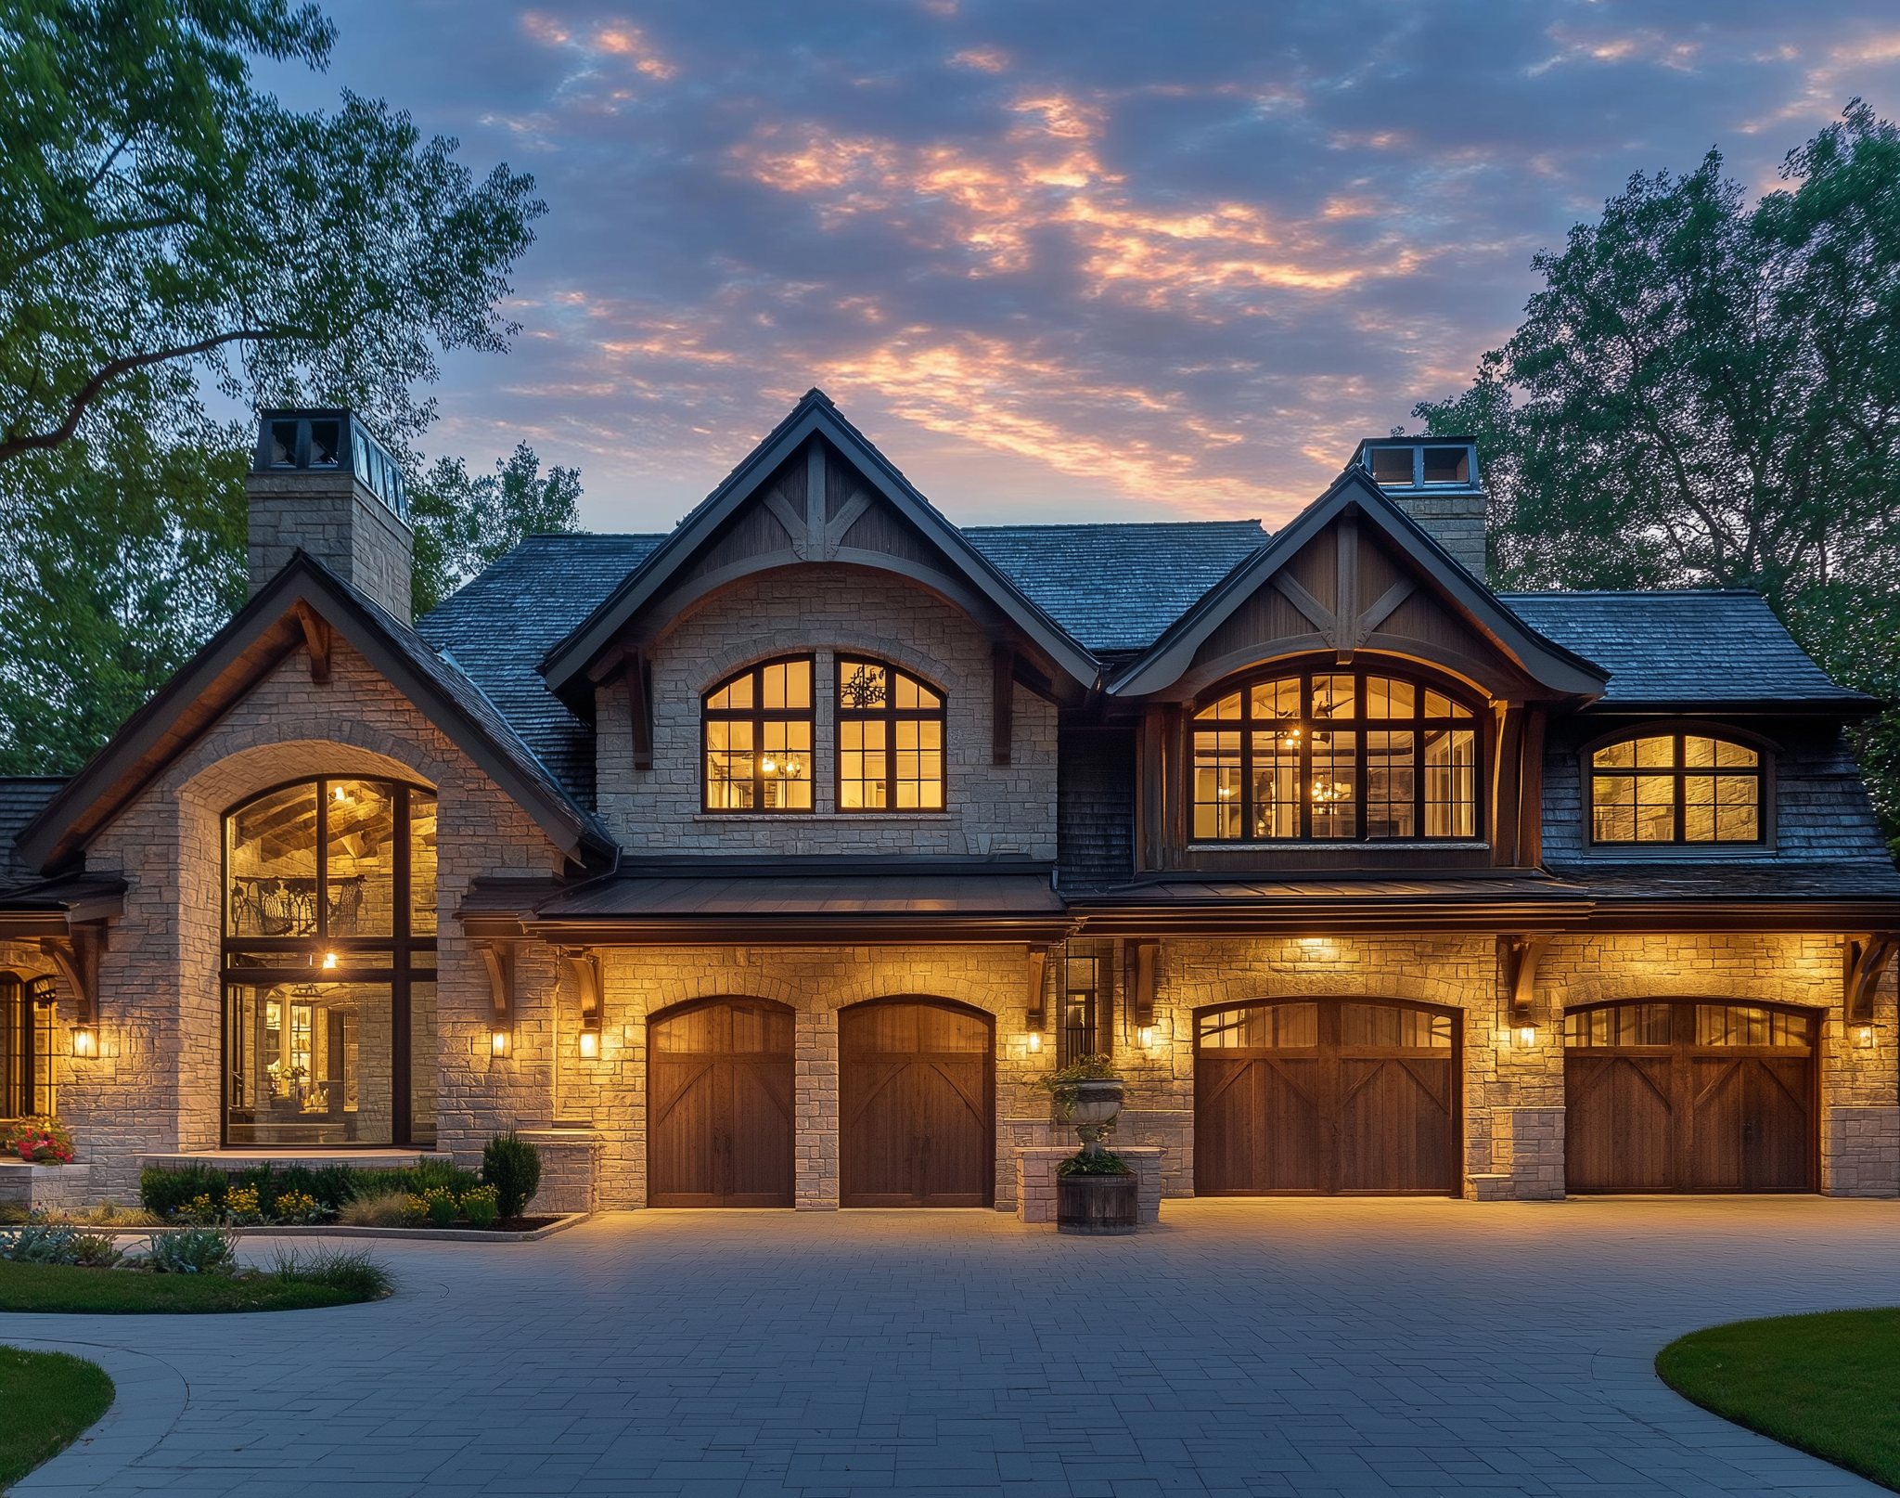
House Price Prediction
Group 15​
Elshad Jafarli • Pamela Kamdefwere • Natthiya Sae Ngow

Slide 2
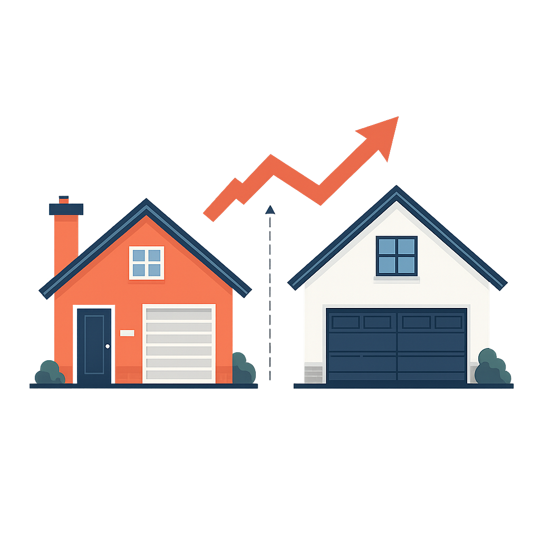

INTRODUCTION TO THE DATASET
House price prediction in the real estate markets of sydney and melbourne.
The dataset contains 2,000 observations and 9 variables. Covering houses built between 1900 to 2023.
This dataset serves as a foundation for building predictive models to estimate house prices based on multiple features.
Identify which variables are the strongest predictors of house prices using linear models to determine their significance.
ANALYSIS GOAL

Slide 3
FEATURE DISTRIBUTIONS : 9 VARIABLES
Data Variables
AREA
Bedrooms
Bathrooms
Floors
Year built
Location
Condition
Garage
Price
: Living area ranges from 500-5000 square feet.
: Number of bedrooms a house has ranging from 1- 5.
: Number of bathrooms a house has ranging from 1- 4.
: Number of floors a house has ranging from 1- 3.
: The year the house was built ranging from 1900 to 2023.
: The house is in a downtown, rural, suburban or urban.
: Ranging from poor, fair, good and excellent.
: This variable is binary classified as either 'Yes' or 'No' and doesn’t include how many garages if it’s more than one.
: Range between from $50,000 up to a $1M (target variable).

Slide 4


Exploratory Data Analysis
Data Cleaning
The data has no null or missing values across any feature.
The dataset contains two data types:
6 Numerical variables: Area, Bedrooms, Bathrooms, Floors, YearBuilt, Price.(Id is excluded as it is used solely as an identifier)
3 Categorical variables: Location, Condition, and Garage
The target variable is Price.

Slide 5
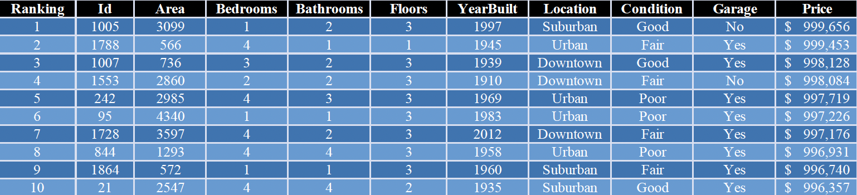
Data observation
Top 10 Most Expensive Houses in Dataset
ID 1005 (1-bedroom) is the most expensive, suggesting that the price likely influenced by location, year, or design, not size alone.
Wide range of home sizes
Mix of old and newer properties
Most homes have 3 floors

Slide 6
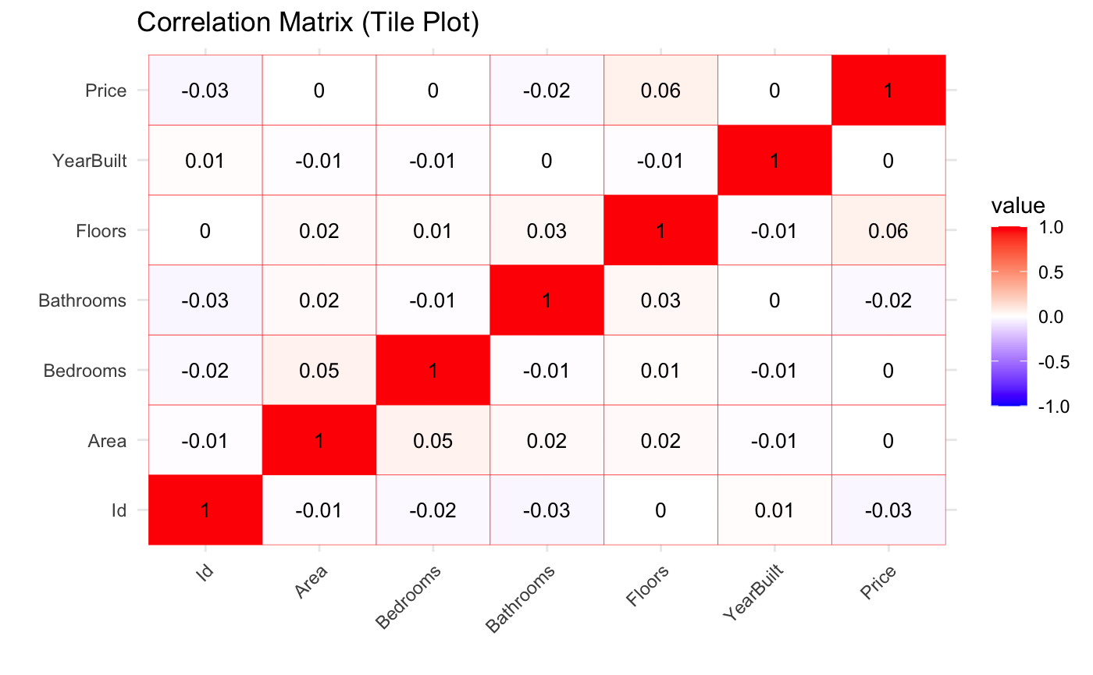
Data Visualization and Correlation Analysis
Correlation matrix of price by numeric variables
Floor has the highest correlation with Price at +0.06.
All off-diagonal values are close to zero, indicating very weak correlations.
The variables are mostly independent of each other.

Slide 7
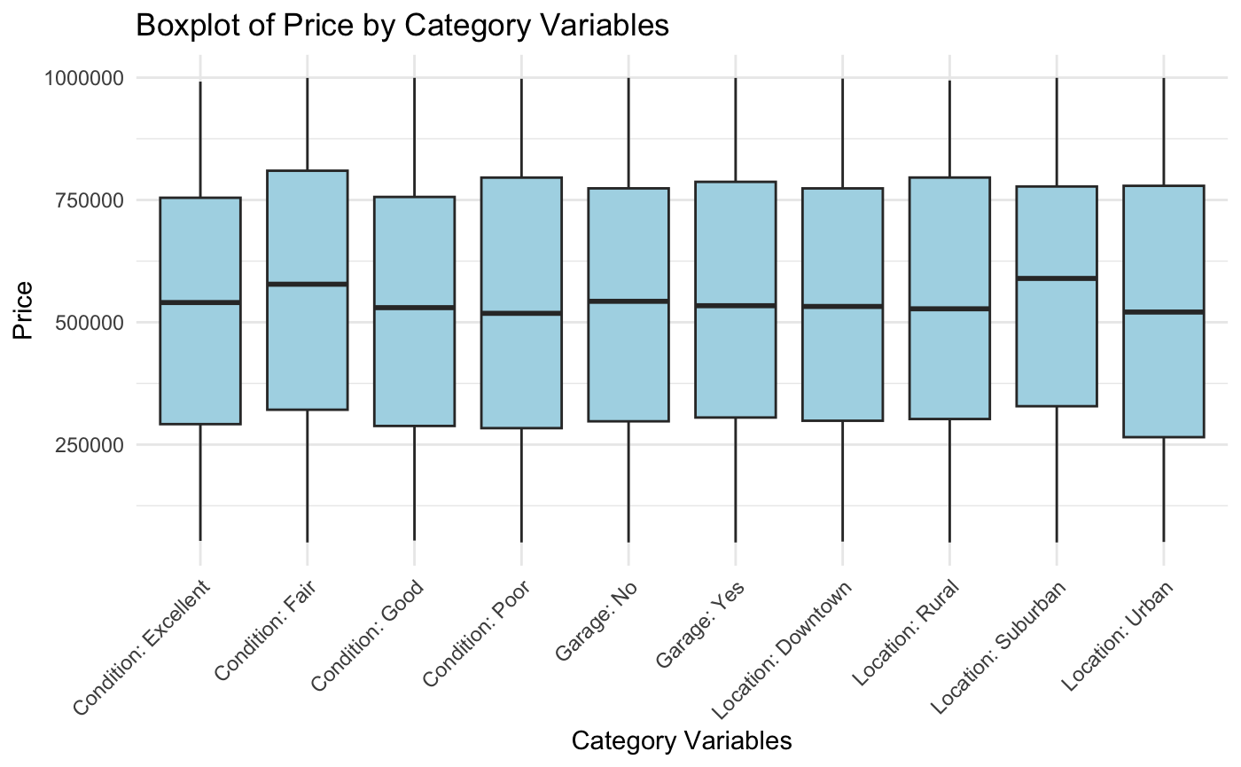
BOXPLOT OF PRICE BY CATEGORY VARIABLES
Homes with a garage (garage: Yes) appear to have a slightly higher median price than those without a garage.
All condition levels show similar price distributions, indicating that Condition is not a strong standalone predictor of house price.
The location in Downtown and Suburban homes have slightly higher median prices, but still overlapping distributions.

Slide 8
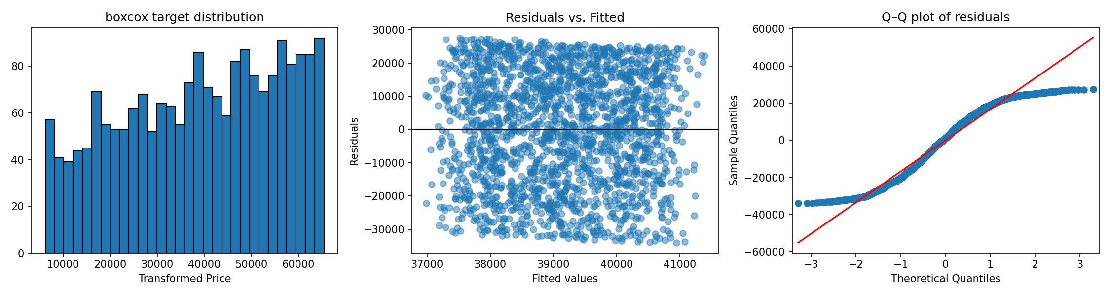
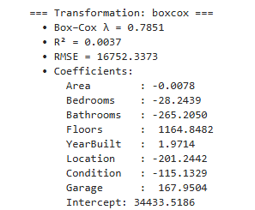
APPLIED TRANSFORMATIONS AND RESIDUALS (PART 1)
BOXCOX transform
Not normally distributed but not skewed heavily either.
Randomly scattered residuals
Fat tails on left and right on Q-Q

Slide 9
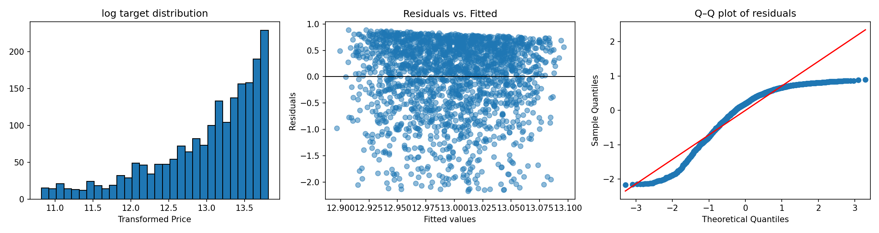
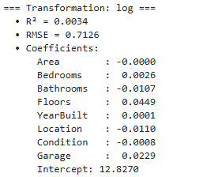
APPLIED TRANSFORMATIONS AND RESIDUALS (PART 2)
Logarithmic transform
Not normally distributed and heavily right skewed.
Higher variance on higher target values
S curve shape indicating strong non-normality heavy tails
On both left and right

Slide 10
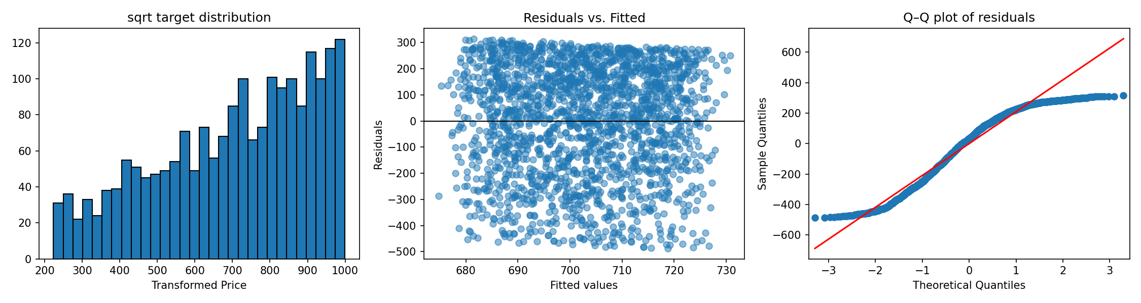
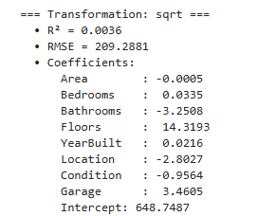
APPLIED TRANSFORMATIONS AND RESIDUALS (PART 3)
Square root transform
Not normally distributed and slight right skew
Randomly scattered residuals
Fat tails on left and right showing signs of S curve but better than Log transform

Slide 11
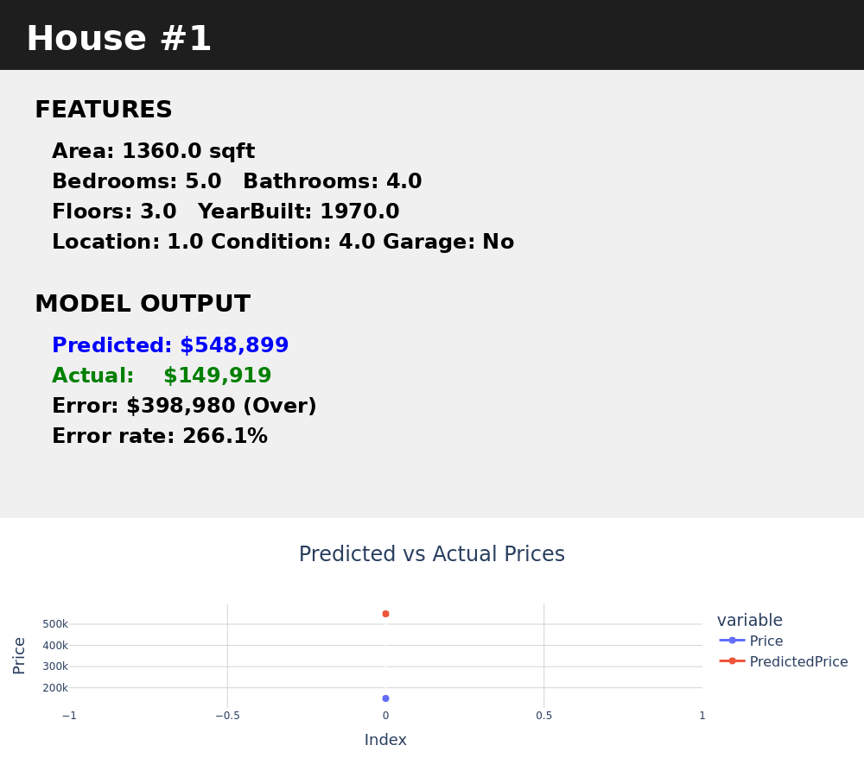
LIVE ENSEMBLE MODEL WITH TRANSFORMATIONS

Slide 12
WHY DID THE LINEAR MODEL NOT EXPLAIN THE VARIANCE?
NOT GOOD ENOUGH PREDICTORS!
DATA DIDN'T INCLUDE:
Property Tax or Assessment History
Amenities
Economic Context (CPI, Inflation, Interest Rates)
Neighborhood-Level Trends (Crime, Walkability, School Zones)
Renovation/Upgrade Metadata
No Buyer Behavior or Seasonality Patterns

Slide 13
Model improvement techniques
Focus:
improving and evaluating a multiple linear regression model to predict house prices.
Method:
using a cleaned version of the dataset and applying transformations and evaluation methods to improve accuracy and interpretability.
AIM:
To build a reliable model, assess prediction performance and propose future improvements

Slide 14
Model overview
Model details
Multiple linear regression model
statistical method used to explain the relationship between one dependent variable (response) and several independent variables (predictors)
Our dependent variable was the log-transformed house price
helps normalize the data making the model assumptions more valid
Response variable: LogPrice (natural logarithm of the Price column)
Predictor variables: All other numeric columns, such as:
bedrooms
bathrooms
sqft_living
sqft_lot
floors
year_built, etc.

Slide 15
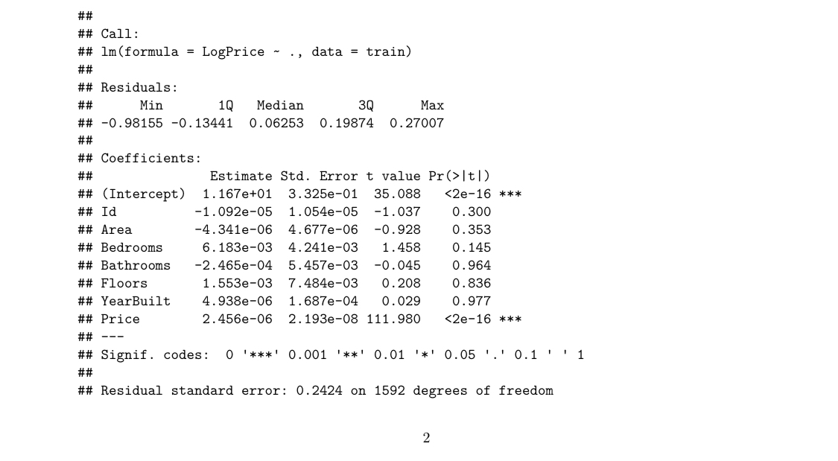

Slide 16
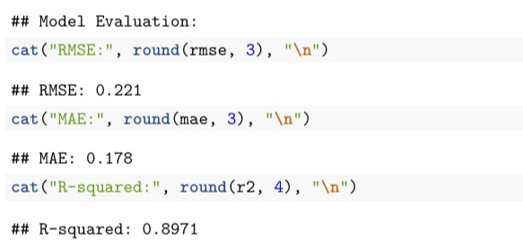
We tested the model on unseen test data and evaluated its prediction performance using:
Root Mean Squared Error (RMSE): Measures the average magnitude of the prediction errors.
Mean Absolute Error (MAE): Measures average absolute difference between predicted and actual values.
R-squared (R²): Measures how much of the variation in house prices is explained by the model.

Slide 17
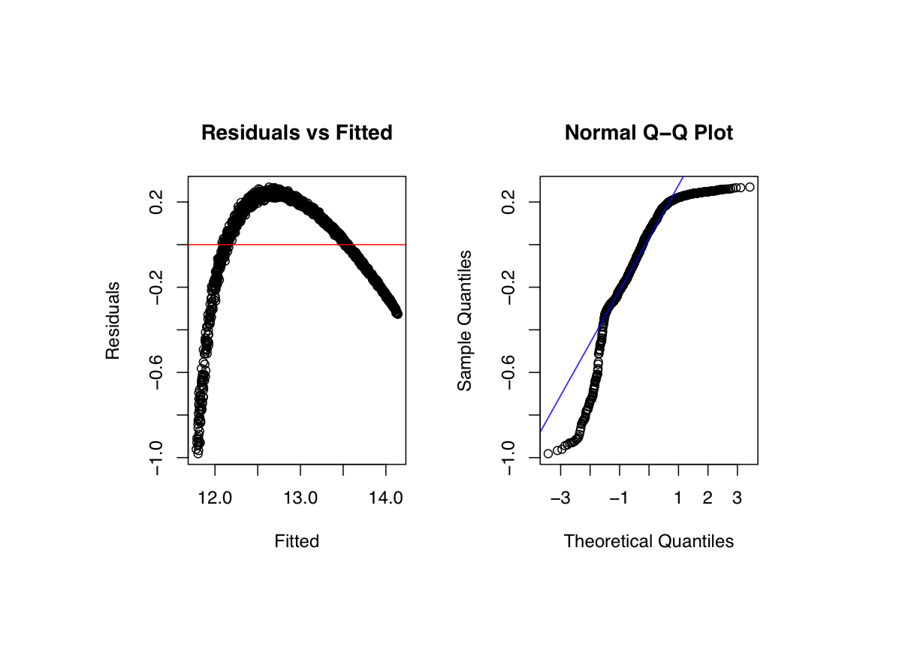

Slide 18
Diagnostic analysis
To check whether our model met the assumptions of linear regression, we created diagnostic plots:
Residuals vs Fitted Plot
Showed that residuals were randomly scattered around 0, indicating a good fit and no strong patterns (which would violate linearity or constant variance assumptions).
Q-Q Plot
Plotted quantiles of residuals against a normal distribution.
Residuals mostly followed the line, supporting the assumption of normally distributed errors.
Multicollinearity Check
We computed a correlation heatmap and VIF (Variance Inflation Factor) to detect multicollinearity:
High correlations between predictors (e.g., sqft_living and sqft_above) suggest redundancy.
Variables with VIF > 5 or 10 were flagged as potentially problematic.

Slide 19
To further enhance the model, we suggest:
Feature Selection: Use stepwise regression or regularization to select the most informative variables.
Nonlinear Modeling: Try Random Forests, Decision Trees, or Gradient Boosting if relationships are not linear.
Data Enrichment: Add new variables such as neighborhood rating, school quality, or crime statistics.
Standardization: Scale features like square footage and year built to improve numerical stability.

Slide 20
Resources
https://www.kaggle.com/datasets/zafarali27/house-price-prediction-dataset/data

